Slide 1
Introduction to spatial data analysis
Materials from Amy Wesolowski and Ben Rice

Slide 2
Identify different types of spatial data.
Identifier différents types de données spatiales
Learn how to read in these types of data in R.
Apprenez à lire dans ces types de données dans R.
Learn how to combine these data.
Apprenez à combiner ces données.
Notes:
Identifier différents types de données spatiales.

Slide 3
1: Introduction - Why do spatial analysis?
2: Visualizing spatial data sets
Software
Different types of spatial data
Reading in and mapping
3: Exploratory data analysis
Mapping multiple sources of spatial data
Summary statistics

Slide 4
Introduction - Why do spatial analysis?
Exploratory Data Analysis
Better describe or
visualize a system

Slide 5
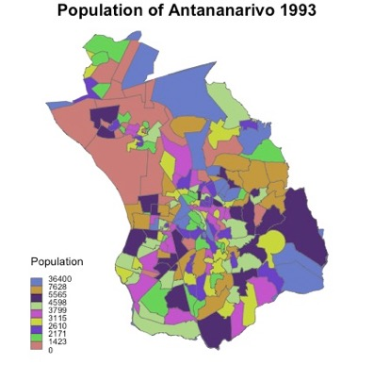
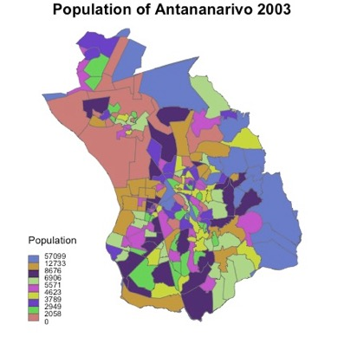
Voalohany: Introduction - Why do spatial analysis?
Ino râ azontsika avy amin’ny ‘spatial analysis’?
Exploratory Data Analysis
Better describe or
visualize a system
Where are Ploughsare tortoises more common?”
Where do you see cases of Newcastle disease in Madagascar?
How is the population of Antananarivo distributed?

Slide 6
Voalohany: Introduction - Why do spatial analysis?
Ino râ azontsika avy amin’ny ‘spatial analysis’?
Exploratory Data Analysis
Better describe or
visualize a system
Where are Ploughsare tortoises more common?”
Implications:
E.g., where to do future studies or where to direct more resources?
How is the population of Antananarivo distributed?
Is there a relationship between the distance to waterpump and mortalities from cholera

Slide 7
Voalohany: Introduction - Why do spatial analysis?
Ino râ azontsika avy amin’ny ‘spatial analysis’?
Spatial modeling
Finding relationships between spatial variables

Slide 8
Voalohany: Introduction - Why do spatial analysis?
Ino râ azontsika avy amin’ny ‘spatial analysis’?
Spatial modeling
Finding relationships between spatial variables
Ohatra: Are ______ and ______ non-randomly distributed?

Slide 9
Voalohany: Introduction - Why do spatial analysis?
Ino râ azontsika avy amin’ny ‘spatial analysis’?
Spatial modeling
Finding relationships between spatial variables
Ohatra: Are ______ and ______ non-randomly distributed?
Deforestation
Rates
Malaria

Slide 10
Voalohany: Introduction - Why do spatial analysis?
Ino râ azontsika avy amin’ny ‘spatial analysis’?
Spatial modeling
Finding relationships between spatial variables
Ohatra: Are ______ and ______ non-randomly distributed?
Deforestation
Rates
Malaria
Implications:
There is a (spatial) relationship
between A and B

Slide 11
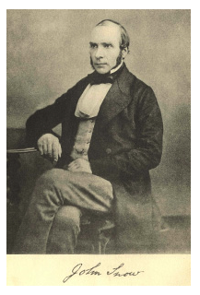

Slide 12

London cholera outbreaks:
1832, 1848-49, 1853-54
Officials thought cholera was
spread of ‘bad air’

Slide 13

Published in 1849
*update in 1855

Slide 14
During the 1853-54 outbreak, Snow conducted a study in Soho, London where ~600 people died
Used government death-registration data and house-to-house interviews to map the victims’ residencies and identified the proximity to water sources

Slide 15
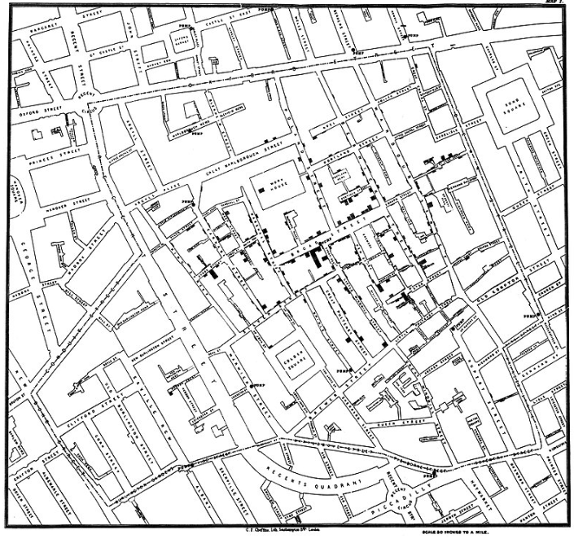
John Snow cholera map (London, 1854)

Slide 16
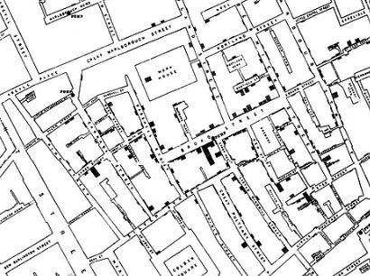
John Snow cholera map (London, 1854)

Slide 17
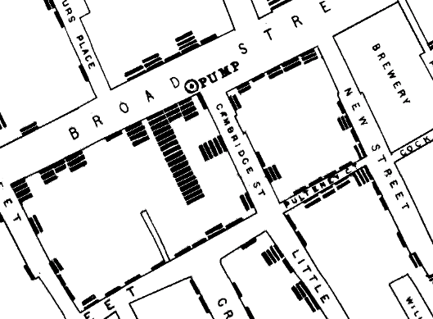
exploratory data analysis of point process data

Slide 18
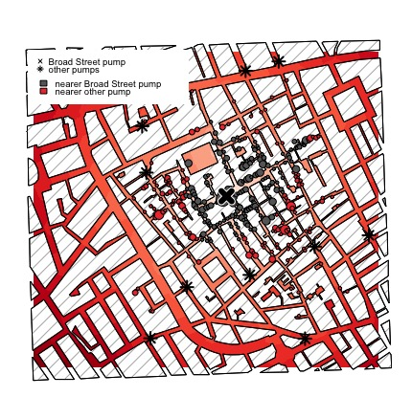
exploratory data analysis of point process data

Slide 19
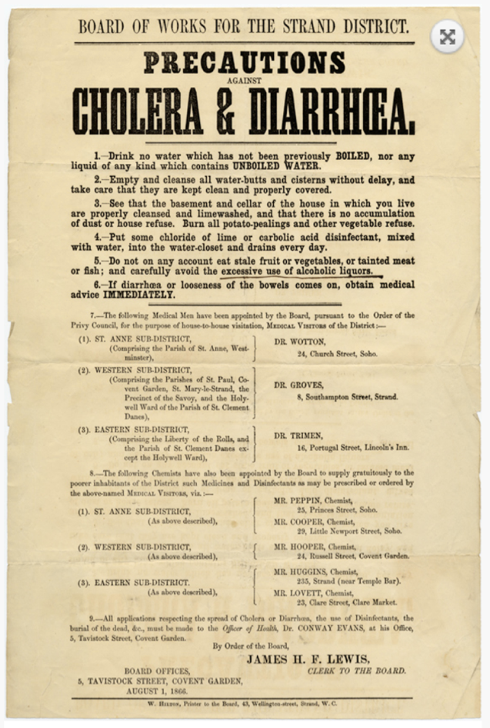
Drink no water which has not been previously boiled nor any liquid of any kind which contains unboiled water.
Empty and cleanse all water-butts and cisterns without delay, and take care that they are kept clean and properly covered.
See that the basement and cellar of the house in which you live are properly cleansed and lime washed, and that there is no accumulation of dust or house refuse. Burn all potato-peelings and other vegetable refuse.
Put some chloride of lime or carbolic acid disinfectant, mixed with water, into the water-closet and drains every day.
Do not on any account eat stale fruit or vegetables or tainted meat or fish; and carefully avoid the excessive use of alcoholic liquors.
If diarrhea or looseness of the bowls comes on, obtain medical advice immediately.

Slide 20



Slide 21
1: Introduction - Why do spatial analysis?
Ino râ azontsika avy amin’ny ‘spatial analysis’?
2: Visualizing spatial data sets
Software
Different types of spatial data
Reading in and mapping
3: Exploratory data analysis
Mapping multiple sources of spatial data
Summary statistics

Slide 22



ArcGIS
QGIS
R
Most commonly used mapping software
Extensive mapping and spatial analysis capabilities
Expensive software, available only on Windows
Freely available version of ArcGIS
Fewer capabilities, but can still do most common mapping things
Statistical software that increasingly has many mapping and spatial statistical capabilities

Slide 23
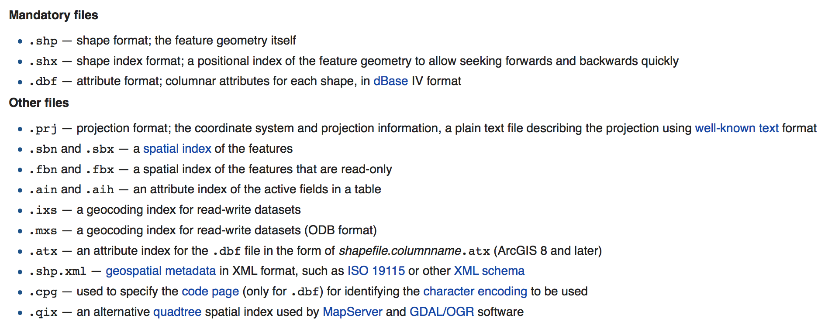
shapefiles
Vector Data
Points, lines, polygons
A standardized data format to use for GIS analysis.
Includes a collection of files

Slide 24
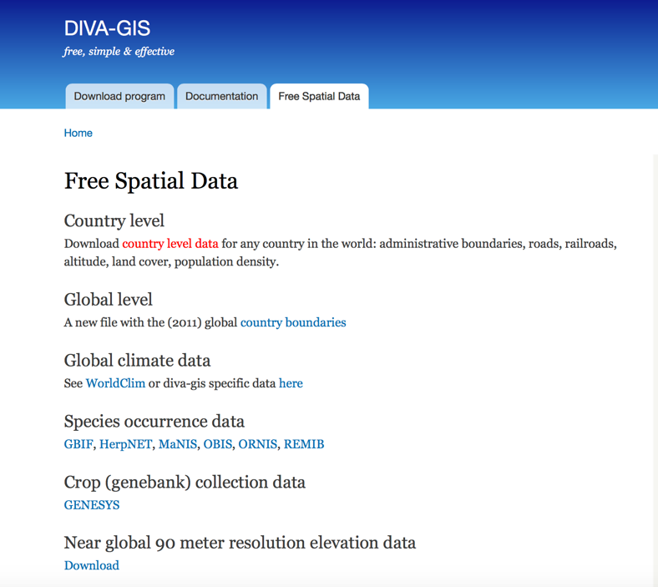
shapefiles
www.diva-gis.org

Slide 25

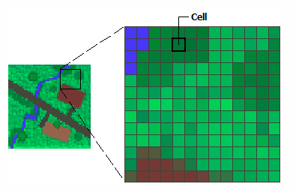

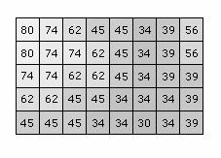
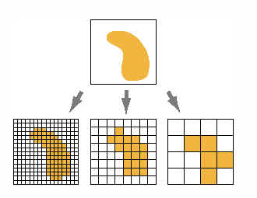
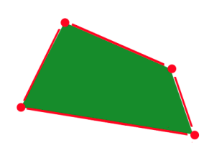
Forms of spatial data
Vector Data
Points, lines, polygons (“shapefiles”)
Raster Data
Area is divided into cell that each contain the value of a point (often continuous)

Slide 26
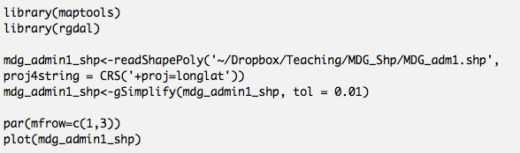
reading shapefiles into R
Libraries
Read in file

Slide 27
reading shapefiles into R
Libraries
Read in file
Plotting

Slide 28
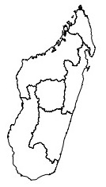
reading shapefiles into R
Libraries
Read in file
Plotting

Slide 29
reading shapefiles into R
Libraries
Read in file
Plotting

Slide 30
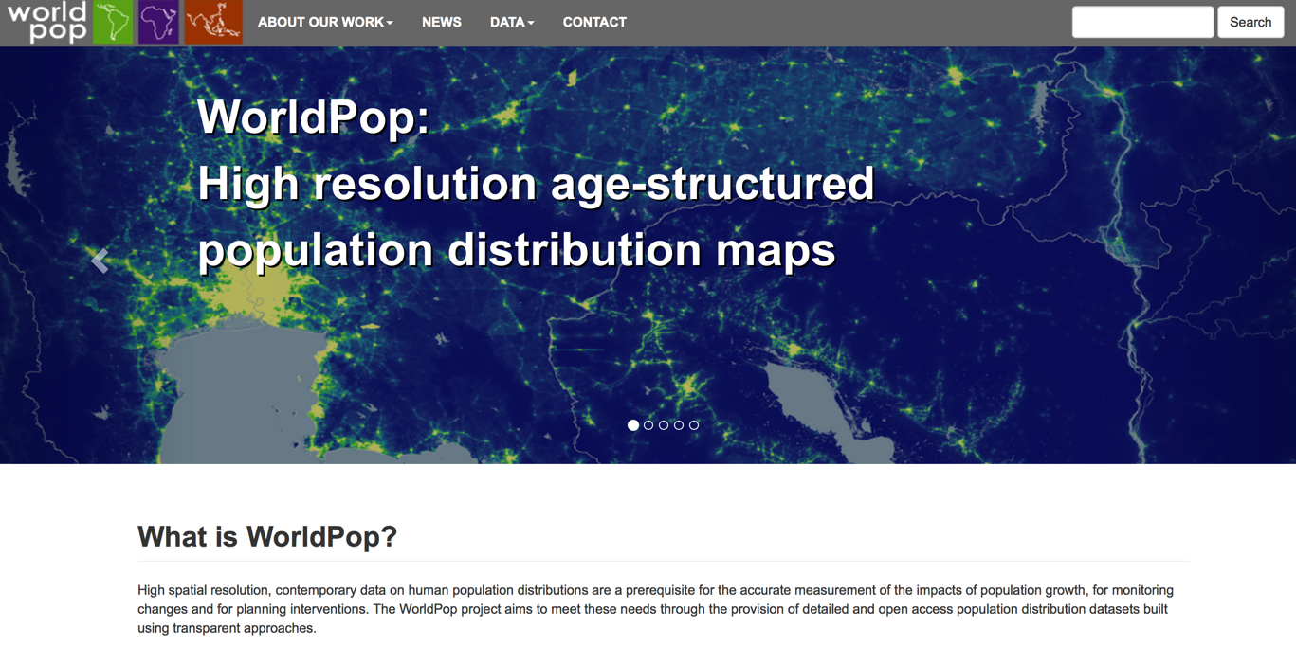
reading population raster data
www.worldpop.org.uk

Slide 31
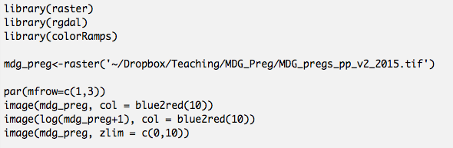
reading population raster data
Libraries
Read in file

Slide 32
reading population raster data
Libraries
Read in file
Plotting

Slide 33
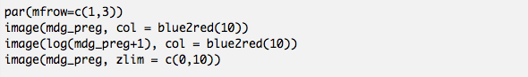
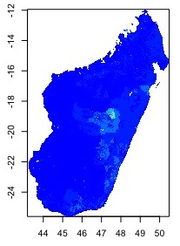
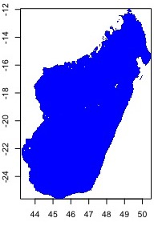
reading population raster data
Plotting

Slide 34
reading population raster data
Plotting

Slide 35
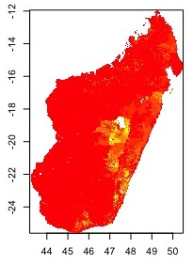
reading population raster data
Plotting

Slide 36
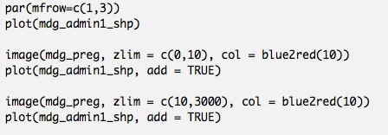
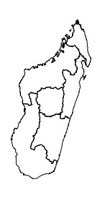
combining raster and shapefiles

Slide 37
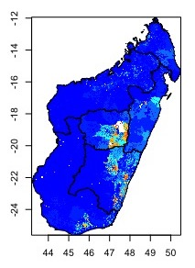
combining raster and shapefiles

Slide 38
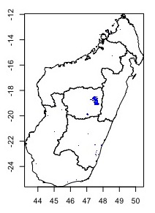
combining raster and shapefiles

Slide 39
1: Introduction - Why do spatial analysis?
Ino râ azontsika avy amin’ny ‘spatial analysis’?
2: Visualizing spatial data sets
Software
Different types of spatial data
Reading in and mapping
3: Exploratory data analysis
Mapping multiple sources of spatial data
Summary statistics

Slide 40
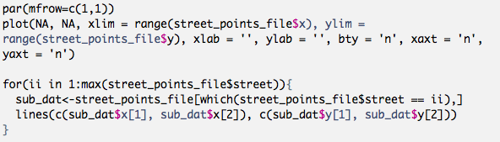
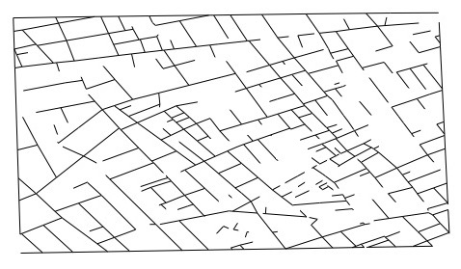
exploratory data analysis of point process data

Slide 41
Key Concepts
There are many different forms of spatial data that can be read into R using specialized functions and packages Il existe de nombreuses formes de données spatiales pouvant être lues dans R en utilisant des fonctions et des packages spécialisés.
It is important that you understand the form of the data and what the spatial scale and variables represent. Il est important que vous compreniez la forme des données et ce que représentent l'échelle spatiale et les variables.
Combining these data in the forms of plots or different statistics can be used to analyze and describe the relationship between these data. La combinaison de ces données sous la forme de graphiques ou de statistiques différentes peut être utilisée pour analyser et décrire la relation entre ces données.
Notes:
Identifier différents types de données spatiales.

Slide 42
Additional helpful resources
http://rspatial.org/analysis/rst/8-pointpat.html
http://zevross.com/blog/2015/03/30/map-and-analyze-raster-data-in-r/
https://cran.r-project.org/doc/contrib/intro-spatial-rl.pdf
https://data.cdrc.ac.uk/tutorial/an-introduction-to-spatial-data-analysis-and-visualisation-in-r
http://www.stats.uwo.ca/faculty/kulperger/S9934a/Computing/Spatstat-pn0y.pdf

Slide 43
loading libraries
library(maptools)
library(raster)
library(rgdal)
library(rgeos)
library(colorRamps)
library(mgcv)
library(maps)
library(googleway)
library(leaflet)

